Slide 1

Flight Price Prediction Using Regression Methods

Slide 2
Problem Statement
Anyone who has booked a flight ticket knows how unexpectedly the prices vary. The cheapest available ticket on a given flight gets more & less expensive over time. This usually happens as an attempt to maximize revenue based on –
Time of purchase patterns (making sure last-minute purchases are expensive)
Keeping the flight as full as they want it (raising prices on a flight which is filling up in order to reduce sales and hold back inventory for those expensive last-minute expensive purchases)
So, you have to work on a project where you collect data of flight fares with other features and work to make a model to predict fares of flights.

Slide 3
Flight Price Prediction
Customers are seeking to get the lowest price for their ticket, while airline companies are trying to keep their overall revenue as high as possible and maximize their profit.
India is the third-biggest avionics showcase in 2020 and the biggest by 2030.
From the customer point of view, determining the minimum price or the best time to buy a ticket is the key issue. The conception of ‘‘tickets bought in advance are cheaper” is no longer working (William Groves and Maria Gini, 2013)

Slide 4
Flight Price Prediction
Predicting the actual ticket price is a more difficult task than predicting an optimal ticket purchase time due to various reasons.
The higher the level of competition, the weaker of the market power of an airline, & then the less likely the chance of the airline fare increases.
In his comparison, Bagging Regression Tree is identified as the best model, which is robust and not affected by using different input feature sets.
The presence of LCC in a market has had a substantial impact on the total passenger volume and the air ticket price.

Slide 5
Web Scraping Strategy employed
Selenium will be used for web scraping data from www.yatra.com
Flights on route of New Delhi to Mumbai in duration of 19 Sep 2022 to 30 Sep 2022.
Data is scrap in three categories:
Economy class flight price extraction
Business class flight price extraction
Premium Economy class price extraction
Selecting features to be scrap from website.
In next part web scraping code executed for above mention details. Exporting final data in Excel file.

Slide 6
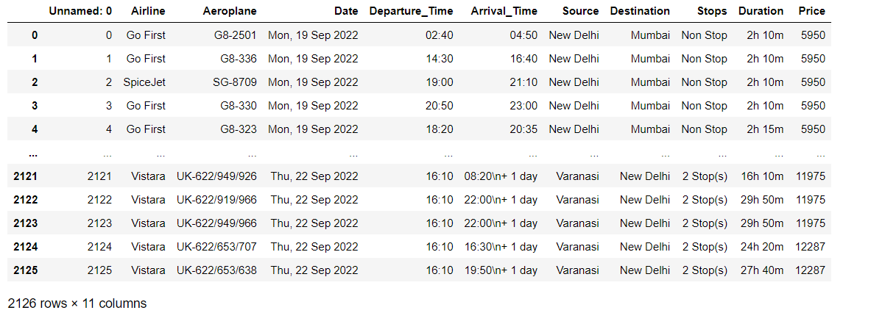
DATA PREPRATION
With the help of Pandas Library, We will upload our data to Jupiter Notebook.
Once our data is uploaded with the help of predefined method (i.e. read_excel) we can read data for further processing.
We have two type of variables in the data:-
Dependent Variable
Independent Variable

Slide 7
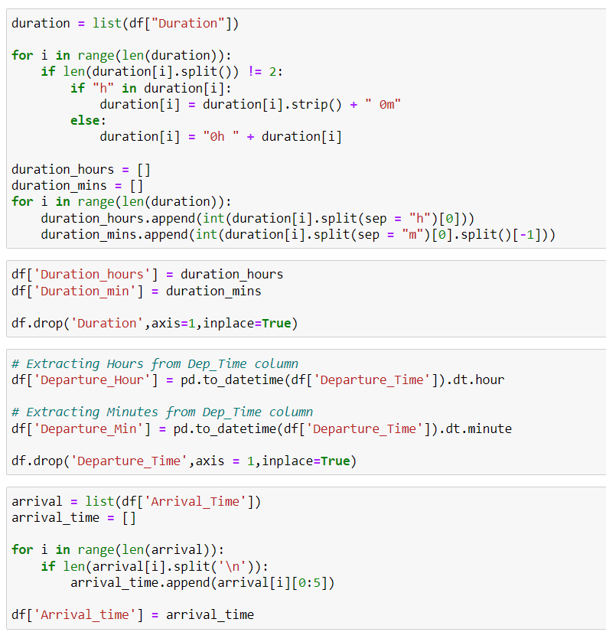
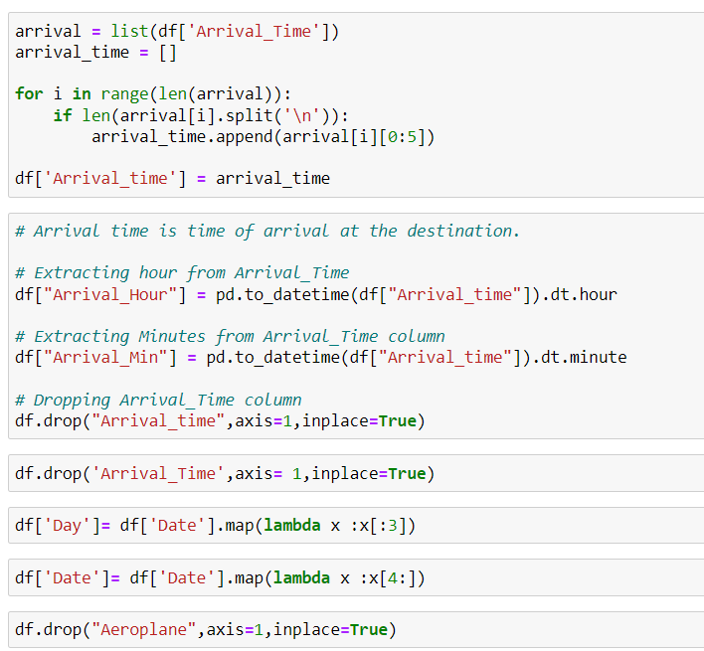
DATA PREPRATION
Conversion of Duration column from Hour & Minutes format into Minutes .
New column for ‘Day’ & ‘Date’ is extracted from Date column.

Slide 8
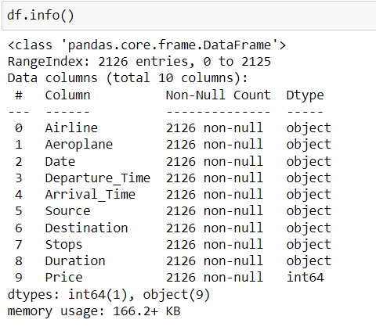
Price is an independent variable whereas all of the other element are dependent variable .

Slide 9
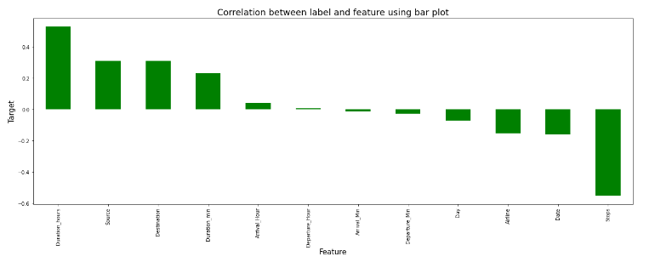
Correlation with Target Variable
We can see that class feature is correlated for more than -0.6 with target variable Price.
Remaining feature are poorly correlated with target variable price.

Slide 10
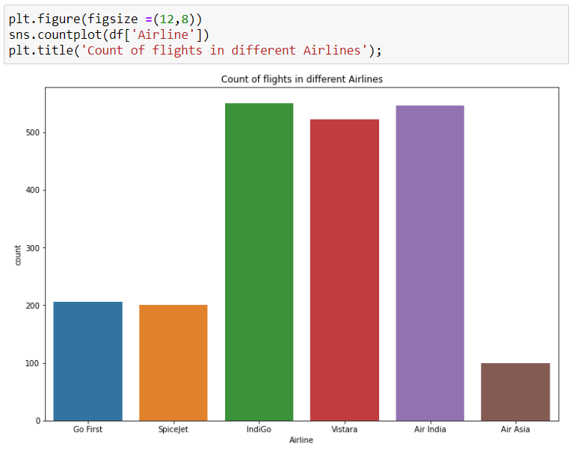
Visualizations
We can see from the graph that indiGo and Air India has the highest counts.

Slide 11
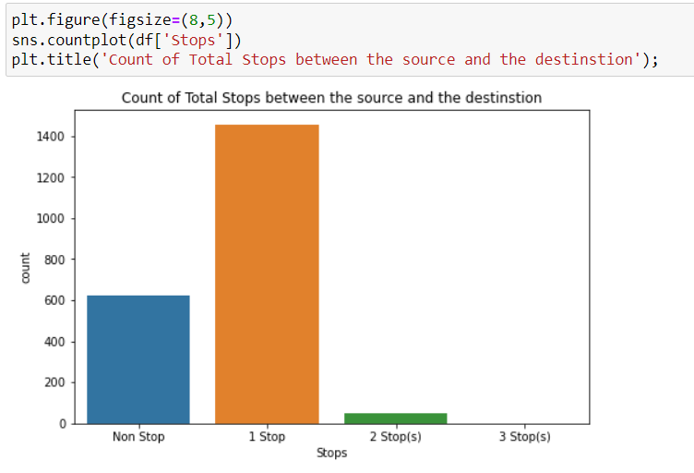
Stop-wise Distribution of Flights
We can see from the graph that 1 Stop has the highest counts.

Slide 12
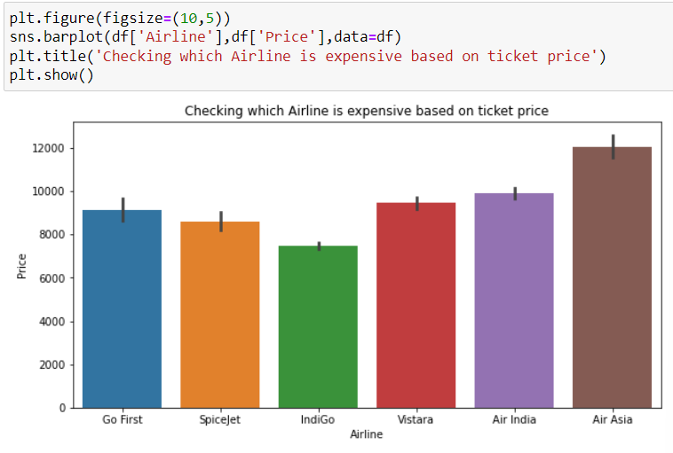
Checking which Airline is expensive
From the plot we can visualize that Air Asia is the most expensive and SpiceJet and IndiGo are the cheapest.

Slide 13
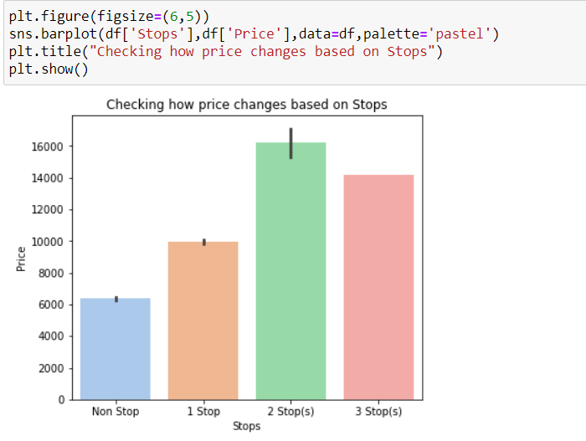
From the plot we can visualized that the flights with 2 Stops have highest price followed by flights having 2 stops and the flights which have no stops is having very less ticket price compared to others.

Slide 14
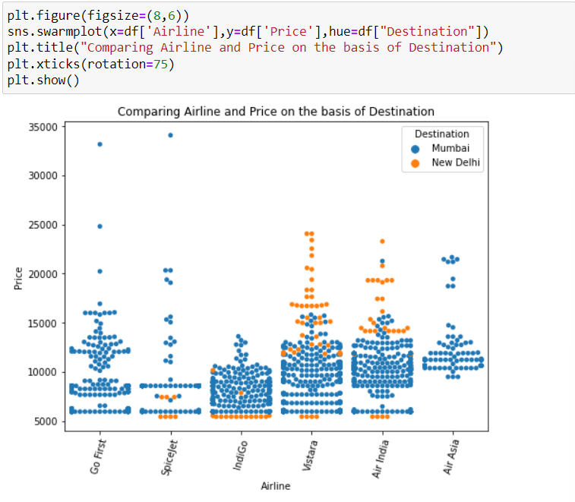
Comparing Airline and Price Base on Destination

Slide 15
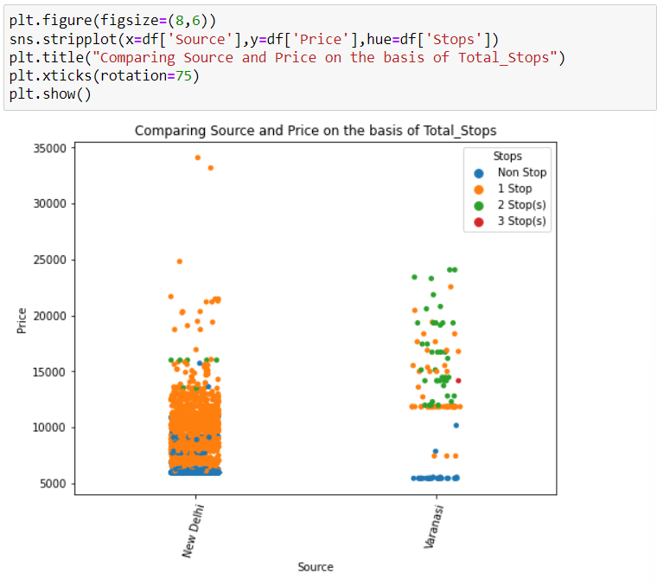
Comparing Source and Price Base on Total_stops

Slide 16
Machine Learning Model Building
This problem can be solve using regression-based machine learning algorithm.
Methodology to Build Machine Learning Model:
Encoding Categorical data into Numerical data
Scaling data using Standard Scalar
Splitting data in training & test data using train_test_split from model_selection
Implementing various Regression Based Algorithm to build ML Model
Conducting 5 fold Cross validation
Hyper Parameter tuning of best Model
Saving Final Tuned Model using Joblib

Slide 17
REGRESSION ALGORITHMS IMPLEMENTATION
Listing down all the algorithms used for the training and testing.
KNeighbors Regressor
Linear Regression
Linear Regression with Ridge
Linear Regression with Lasso
Gradient Boosting Regressor
Bagging Regressor
Extra Trees Regressor
XGB Regressor
Decision Tree Regressor
Random Forest Regressor

Slide 18
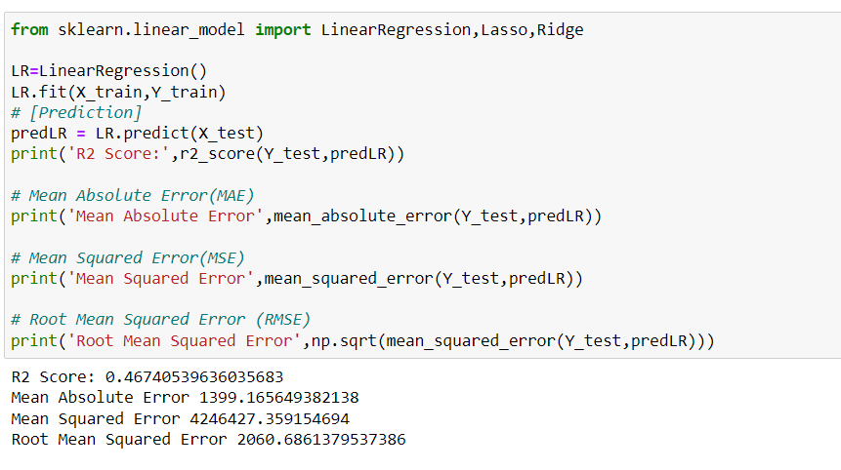
Linear Regression

Slide 19
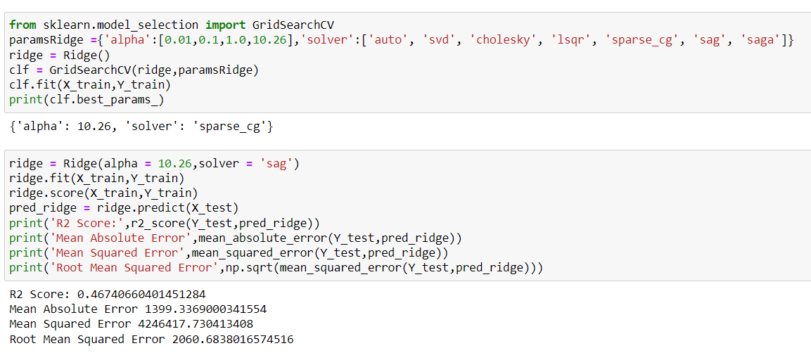
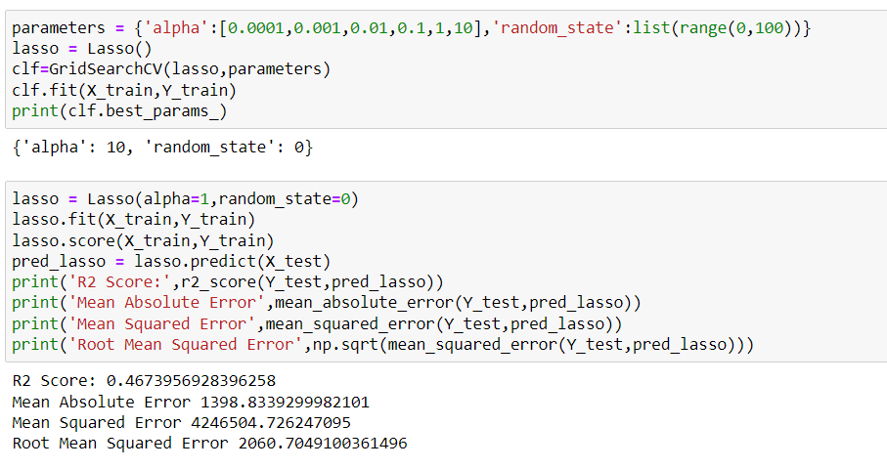
Linear Regression with Ridge and Lasso

Slide 20
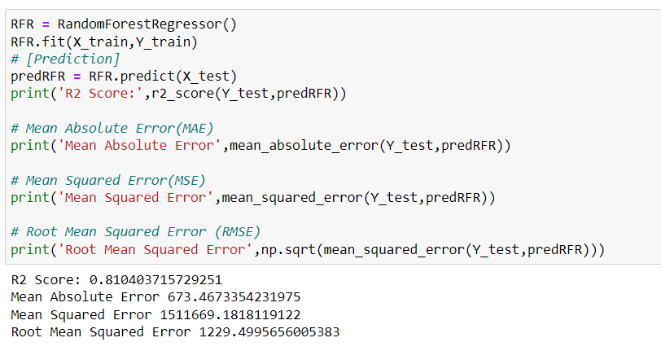
Random Forest Regression

Slide 21
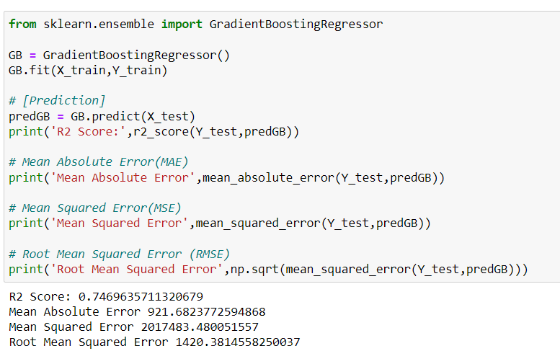
Gradient Boosting Regressor

Slide 22
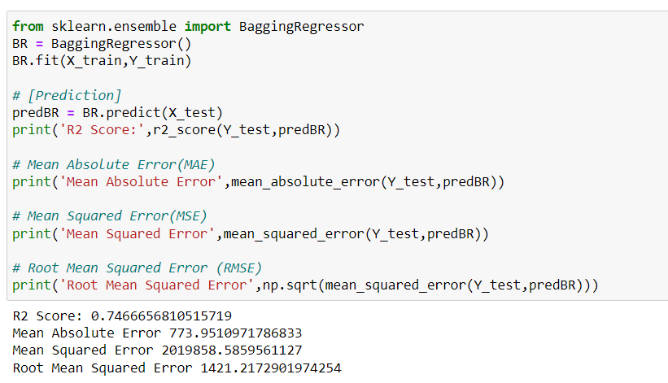
Bagging Regressor

Slide 23
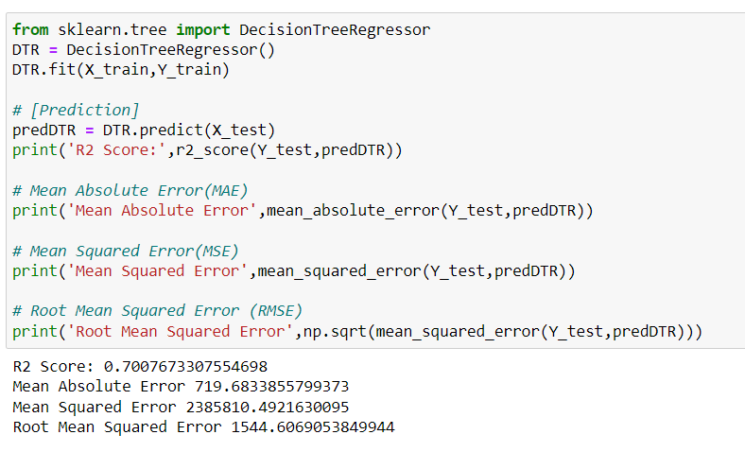
Decision Tree Regressor

Slide 24
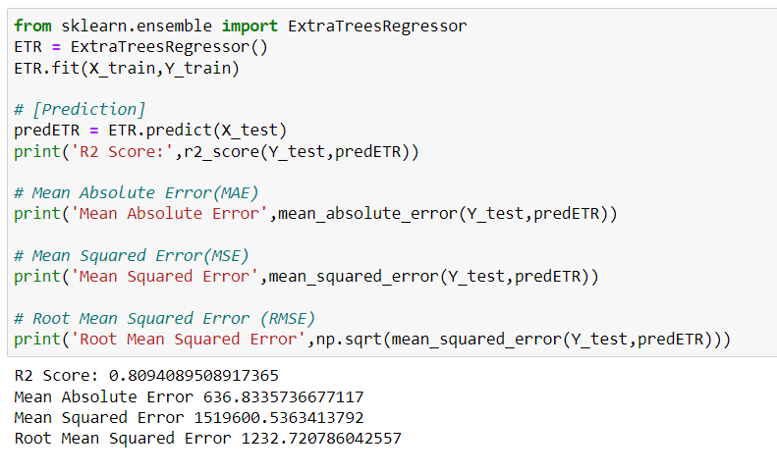
Extra Trees Regressor

Slide 25
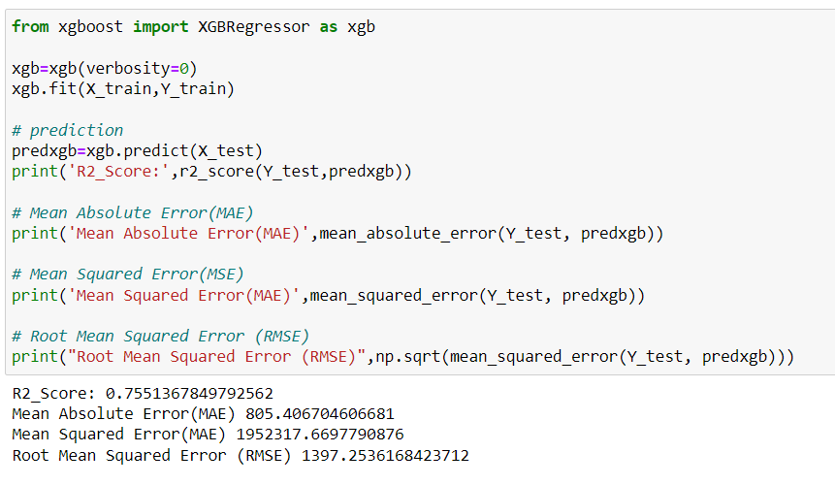
XGB Regressor

Slide 26
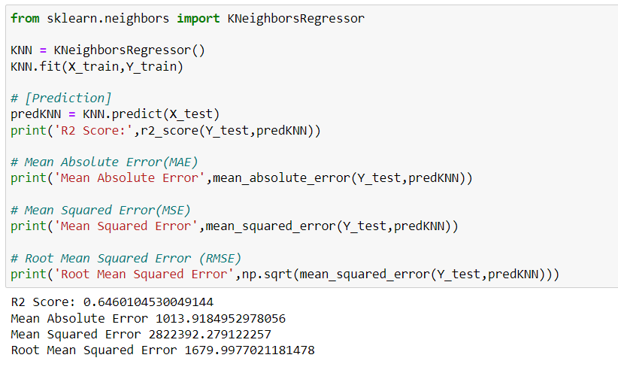
K Neighbors Regression

Slide 27
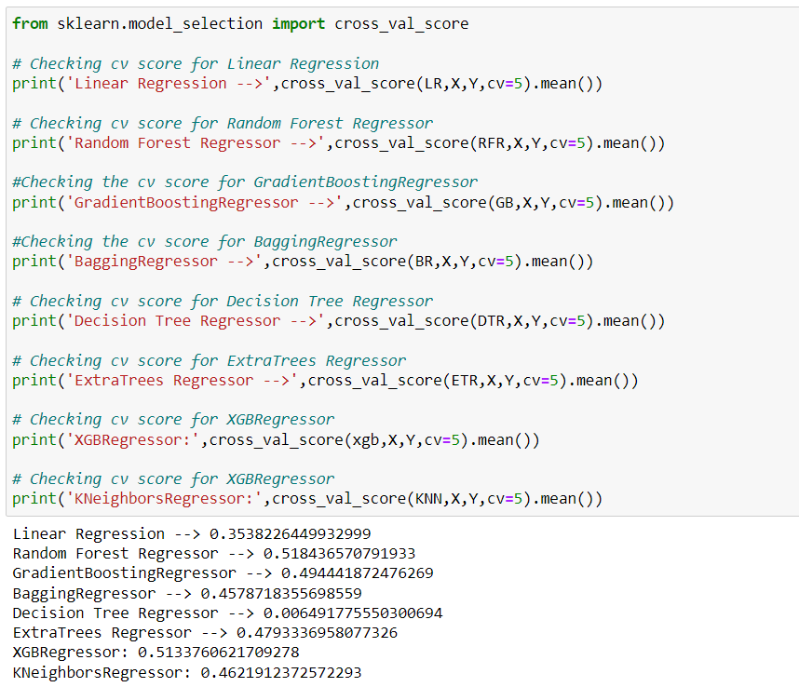
Cross Validation

Slide 28
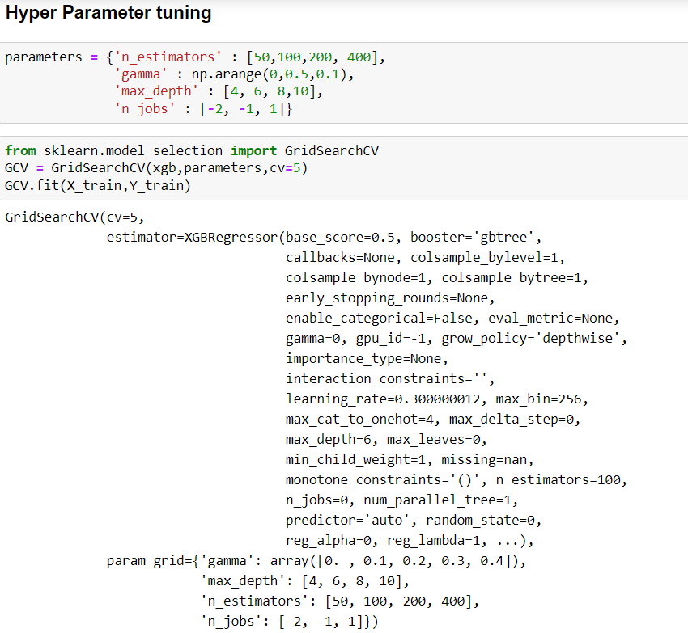
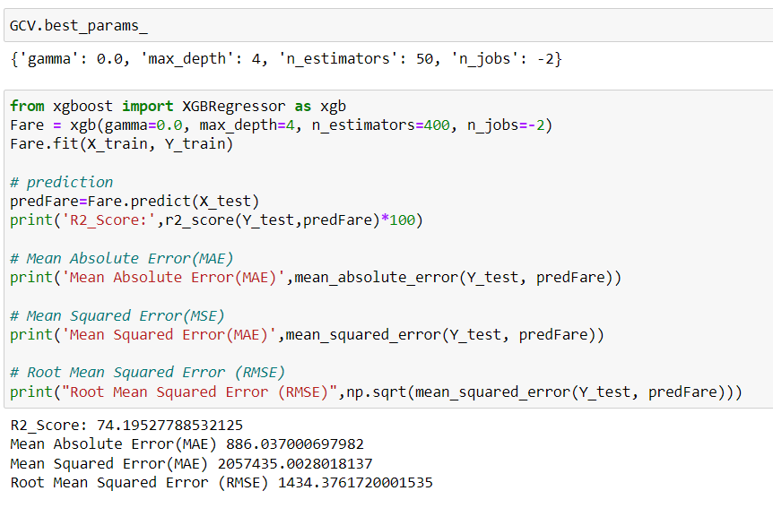
Hyper Parameter Tuning of Best Model

Slide 29
CONCLUSION
From this dataset I get to know that each feature plays a very import role to understand the data.
Data format plays a very important role in the visualization and Appling the models and algorithms.
The power of visualization is helpful for the understanding of data into the graphical representation its help me to understand that what data is trying to say.
Data cleaning is one of the most important steps to remove missing value or null value fill it by mean median .
The best algorithm is Random Forest Regressor.

Slide 30
Thank you

